Slide 1
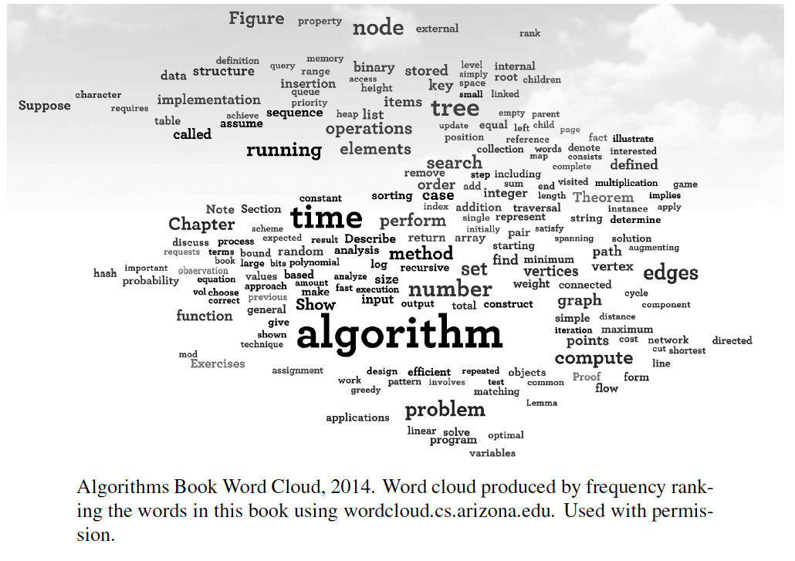
String Algorithms
Presentation for use with the textbook, Algorithm Design and Applications, by M. T. Goodrich and R. Tamassia, Wiley, 2015

Slide 2

Strings
A string is a sequence of characters
Examples of strings:
Python program
HTML document
DNA sequence
Digitized image
An alphabet Σ is the set of possible characters for a family of strings
Example of alphabets:
ASCII
Unicode
{0, 1}
{A, C, G, T}
Let P be a string of size m
A substring P[i .. j] of P is the subsequence of P consisting of the characters with ranks between i and j
A prefix of P is a substring of the type P[0 .. i]
A suffix of P is a substring of the type P[i ..m − 1]
Given strings T (text) and P (pattern), the pattern matching problem consists of finding a substring of T equal to P
Applications:
Text editors
Search engines
Biological research

Slide 3
Brute-Force Pattern Matching
Algorithm BruteForceMatch(T, P)
Input text T of size n and pattern P of size m
Output starting index of a substring of T equal to P or −1 if no such substring exists
for i ← 0 to n − m
{ test shift i of the pattern }
j ← 0
while j < m ∧ T[i + j] = P[j]
j ← j + 1
if j = m
return i {match at i}
else
break while loop {mismatch}
return -1 {no match anywhere}
The brute-force pattern matching algorithm compares the pattern P with the text T for each possible shift of P relative to T, until either
a match is found, or
all placements of the pattern have been tried
Brute-force pattern matching runs in time O(nm)
Example of worst case:
T = aaa … ah
P = aaah
may occur in images and DNA sequences
unlikely in English text

Slide 4
Boyer-Moore Heuristics
The Boyer-Moore’s pattern matching algorithm is based on two heuristics
Looking-glass heuristic: Compare P with a subsequence of T moving backwards
Character-jump heuristic: When a mismatch occurs at T[i] = c
If P contains c, shift P to align the last occurrence of c in P with T[i]
Else, shift P to align P[0] with T[i + 1]
Example

Slide 5
Last-Occurrence Function
Boyer-Moore’s algorithm preprocesses the pattern P and the alphabet Σ to build the last-occurrence function L mapping Σ to integers, where L(c) is defined as
the largest index i such that P[i] = c or
−1 if no such index exists
Example:
Σ = {a, b, c, d}
P = abacab
The last-occurrence function can be represented by an array indexed by the numeric codes of the characters
The last-occurrence function can be computed in time O(m + s), where m is the size of P and s is the size of Σ
c | a | b | c | d
L(c) | 4 | 5 | 3 | −1

Slide 6
The Boyer-Moore Algorithm
Case 1: j < 1 + l; shift pattern by one
Algorithm BoyerMooreMatch(T, P, Σ)
L ← lastOccurenceFunction(P, Σ )
i ← m − 1
j ← m − 1
repeat
if T[i] = P[j]
if j = 0
return i { match at i }
else
i ← i − 1
j ← j − 1
else
{ character-jump }
l ← L[T[i]]
i ← i + m – min(j, 1 + l)
j ← m − 1
until i > n − 1
return −1 { no match }
Case 2: 1 + l ≤ j; shift pattern by j-l

Slide 7
Example

Slide 8
Analysis
Boyer-Moore’s algorithm runs in time O(nm + s)
Example of worst case:
T = aaa … a
P = baaaaa
The worst case may occur in images and DNA sequences but is unlikely in English text
Boyer-Moore’s algorithm is significantly faster than the brute-force algorithm on English text

Slide 9
The KMP Algorithm
Knuth-Morris-Pratt’s algorithm compares the pattern to the text in left-to-right, but shifts the pattern more intelligently than the brute-force algorithm.
When a mismatch occurs, what is the most we can shift the pattern so as to avoid redundant comparisons?
Answer: the largest prefix of P[0..j] that is a suffix of P[1..j]
.
.
a
b
a
a
b
x
.
.
.
.
.
a
b
a
a
b
a
j
a
b
a
a
b
a
No need to
repeat these
comparisons
Resume
comparing
here

Slide 10
KMP Failure Function
Knuth-Morris-Pratt’s algorithm preprocesses the pattern to find matches of prefixes of the pattern with the pattern itself
The failure function F(j) is defined as the size of the largest prefix of P[0..j] that is also a suffix of P[1..j]
Knuth-Morris-Pratt’s algorithm modifies the brute-force algorithm so that if a mismatch occurs at P[j] ≠ T[i] we set j ← F(j − 1)
j | 0 | 1 | 2 | 3 | 4 | 5
P[j] | a | b | a | a | b | a
F(j) | 0 | 0 | 1 | 2 | 2 | 3

Slide 11
The KMP Algorithm
The failure function can be represented by an array and can be computed in O(m) time (see next slide)
At each iteration of the while-loop, either
i increases by one, or
the shift amount i − j increases by at least one (observe that F(j − 1) < j)
Hence, there are no more than 2n iterations of the while-loop
Thus, KMP’s algorithm runs in optimal time O(m + n)
Algorithm KMPMatch(T, P)
F ← failureFunction(P)
i ← 0
j ← 0
while i < n
if T[i] = P[j]
if j = m − 1
return i − j { match }
else
i ← i + 1
j ← j + 1
else
if j > 0 (we have advanced in P)
j ← F[j − 1]
else
i ← i + 1
return −1 { no match }

Slide 12
Computing the Failure Function
The failure function can be represented by an array and can be computed in O(m) time
The construction is similar to the KMP algorithm itself
At each iteration of the while-loop, either
i increases by one, or
the shift amount i − j increases by at least one (observe that F(j − 1) < j)
Hence, there are no more than 2m iterations of the while-loop
Algorithm failureFunction(P)
F[0] ← 0
i ← 1
j ← 0
while i < m
if P[i] = P[j]
{we have matched j + 1 chars}
F[i] ← j + 1
i ← i + 1
j ← j + 1
else if j > 0 then
{use failure function to shift P}
j ← F[j − 1]
else
F[i] ← 0 { no match }
i ← i + 1

Slide 13
Example
j | 0 | 1 | 2 | 3 | 4 | 5
P[j] | a | b | a | c | a | b
F(j) | 0 | 0 | 1 | 0 | 1 | 2

Slide 14
Karp-Rabin
The Rabin-Karp string searching algorithm calculates a hash value for the pattern, and for each M-character subsequence of text to be compared.
If the hash values are unequal, the algorithm will calculate the hash value for next M-character sequence.
If the hash values are equal, the algorithm will do a Brute Force comparison between the pattern and the M-character sequence.
In this way, there is only one comparison per text subsequence, and Brute Force is only needed when hash values match.
Perhaps an example will clarify some things...

Slide 15
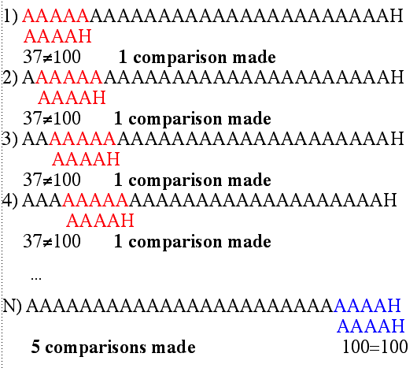
Karp-Rabin Example
Hash value of “AAAAA” is 37
Hash value of “AAAAH” is 100

Slide 16
Karp-Rabin Algorithm
Pattern is M characters long
hash_p=hash value of pattern
hash_t=hash value of first M letters in body of text
do
if (hash_p = hash_t)
brute force comparison of the pattern and selected section of text
hash_t != hash_p shift one character over
while (end of text or brute force comparison = true)

Slide 17
Karp-Rabin
Total number of comparisons: M*(N-M+1)
Worst case time complexity: O(MN)
Common Rabin-Karp questions:
“What is the hash function used to calculate values for character sequences?”
Use Uniform Hash functions: that is a hash function h such that for any pattern P_{k} in L, the number of other patterns P_{j} such that h(P_{j}) = h(P_{k}) is O(1)
In other words, the hash values for string in L is uniformly distributed
“Isn’t it time consuming to hash every one of the M- character sequences in the text body?”
We can do it smartly.
Lets get mathematical:

Slide 18

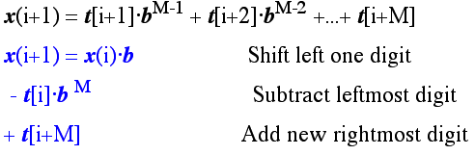
Karp-Rabin Math
Consider an M-character sequence as an M-digit number in base b, where b is the number of letters in the alphabet. The text subsequence t[i .. i+M-1] is mapped to the number
Furthermore, given x(i) we can compute x(i+1) for the next subsequence t[i+1 .. i+M] in constant time, as follows:
In this way, we never explicitly compute a new value. We simply adjust the existing value as we move over one character.
For example if m=5 and X(i)=31415, then we remove 3, bring the new low order, say 2, and let X(i+1) = 10(31415) – 3(10000) +2

Slide 19
Karp-Rabin Math Example
Let’s say that our alphabet consists of 10 letters.
our alphabet = a, b, c, d, e, f, g, h, i, j
Let’s say that “a” corresponds to 1, “b” corresponds to 2 and so on.
The hash value for string “cah” would be ...
3*100 + 1*10 + 8*1 = 318

Slide 20
Karp-Rabin Mods
If M is large, then the resulting value (~b^{M}) will be enormous. For this reason, we hash the value by taking it mod a prime number q.
The mod function (% in Java) is particularly useful in this case due to several of its inherent properties:
[(x mod q) + (y mod q)] mod q = (x+y) mod q
(x mod q) mod q = x mod q
For these reasons:
h(i)=((t[i]⋅ b^{M-1} mod q) +(t[i+1]⋅ b^{M-2} mod q) + ...
+(t[i+M-1] mod q))mod q
h(i+1) =( h(i) ⋅ b mod q
Shift left one digit
-t[i] ⋅ b^{M} mod q
Subtract leftmost digit
+t[i+M] mod q )
Add new rightmost digit

Slide 21
Karp-Rabin Complexity
If a sufficiently large prime number is used for the hash function, the hashed values of two different patterns will usually be distinct.
If this is the case, searching takes O(N) time, where N is the number of characters in the larger body of text T.
Computing h(X) for any string X of length M takes O(M). Hence, computing h for all substring of T takes O(NM).
Therefore Karp-Rabin Algorithm runs in O(NM).

Slide 22
Tries
Presentation for use with the textbook, Algorithm Design and Applications, by M. T. Goodrich and R. Tamassia, Wiley, 2015

Slide 23
Preprocessing Strings
Preprocessing the pattern speeds up pattern matching queries
After preprocessing the pattern, KMP algorithm performed pattern matching in time proportional to n+m.
If the text is large, fixed, and searched for often (e.g., works by Shakespeare), we may want to preprocess the text instead of the pattern
A trie is a compact data structure for representing a set of strings, such as all the words in a text
A tries supports pattern matching queries in time proportional to the pattern size

Slide 24
Standard Tries
The standard trie for a set of strings S is an ordered tree such that:
No string in S is a prefix of another string in S
Each node but the root is labeled with a character
The children of a node are alphabetically ordered
The paths from the root to the external nodes yield the strings of S
Each external node is associated with a string of S.
Example: standard trie for the set of strings
S = { bear, bell, bid, bull, buy, sell, stock, stop }

Slide 25
Analysis of Standard Tries
A standard trie uses O(n) space and supports searches, insertions and deletions in time O(dm), where:
n total size of the strings in S
m size of the string parameter of the operation (height of tree)
d size of the alphabet (max # of children of an internal node)
A path from root to an internal node gives prefixes of an string in S.

Slide 26
Word Matching with a Trie
insert the words of the text into trie
Each leaf is associated w/ one particular word
leaf stores indices associated with where word begins (“see” starts at index 0 & 24, leaf for “see” stores those indices)
s
e
e
a
b
e
a
r
?
s
e
l
l
s
t
o
c
k
!
0
1
2
3
4
5
6
7
8
9
10
11
12
13
14
15
16
17
18
19
20
21
22
23
s
e
e
a
b
u
l
l
?
b
u
y
s
t
o
c
k
!
24
25
26
27
28
29
30
31
32
33
34
35
36
37
38
39
40
41
42
43
44
45
46
b
i
d
s
t
o
c
k
!
b
i
d
s
t
o
c
k
!
47
48
49
50
51
52
53
54
55
56
57
58
59
60
61
62
63
64
65
66
67
68
h
e
a
r
t
h
e
b
e
l
l
?
s
t
o
p
!
69
70
71
72
73
74
75
76
77
78
79
80
81
82
83
84
85
86
87
88
b
h
s
e
i
u
e
e
t
a
l
d
l
y
a
e
l
o
47, 58
36
0, 24
r
l
l
r
l
c
p
6
78
30
69
12
84
k
17, 40,
51, 62

Slide 27
Compressed Tries
A compressed trie has internal nodes of degree at least two
It is obtained from standard trie by compressing chains of “redundant” nodes
ex. the “i” and “d” in “bid” are “redundant” because they signify the same word

Slide 28
Compact Representation
Compact representation of a compressed trie for an array of strings:
Stores at the nodes ranges of indices instead of substring X as a triplet (i,j,k) where X=S[i][j..k] of string S[i] from jth to kth index.
Uses O(s) space, where s is the number of strings in the array
Serves as an auxiliary index structure

Slide 29
Suffix Trie
The suffix trie of a string X is the compressed trie of all the suffixes of X

Slide 30
Analysis of Suffix Tries
Compact representation of the suffix trie for a string X of size n from an alphabet of size d
Uses O(n) space (Theorem 23.6)
Can be constructed in O(dn) time (Proof beyond this course)
Supports arbitrary pattern matching queries in X in O(dm) time, where m is the size of the pattern (Algorithm 23.19)

Slide 31
Encoding Trie (1)
A code is a mapping of each character of an alphabet to a binary code-word
A prefix code is a binary code such that no code-word is the prefix of another code-word
An encoding trie represents a prefix code
Each leaf stores a character
The code word of a character is given by the path from the root to the leaf storing the character (0 for a left child and 1 for a right child)
Huffman code is a particular type of Prefix Code.
00 | 010 | 011 | 10 | 11
a | b | c | d | e
a
d
e
b
c

Slide 32
Encoding Trie (2)
Given a text string X, we want to find a prefix code for the characters of X that yields a small encoding for X
Frequent characters should have short code-words
Rare characters should have long code-words
Example
X = abracadabra
T₁ encodes X into 29 bits
T₂ encodes X into 24 bits
T₁
T₂
c
d
b
a
b
r
a
r
c
d

